Slide 1
Data and Procedural Abstraction

Slide 2
Object-Oriented Concepts
Object-oriented analysis and design (OOAD)
  Process for solving problems
Solution
  Computer program consisting of system of interacting classes of objects
Object
  Has set of characteristics, behaviors related to solution
  SINGLE instance of a “thing”

Slide 3
Object-Oriented Analysis & Design
Requirements of a solution
  What solution must be, do
Object-oriented design
  Describe solution to problem
  Express solution in terms of software objects and “things”
  What are the ACTIONS on the objects and “things”
  Create one or more models of solution

Slide 4
Aspects of Object-Oriented Solution
Principles of object-oriented programming
Encapsulation: Objects combine data and operations.
Inheritance: Classes inherit properties from other classes.
Polymorphism: Objects determine appropriate operations at execution time.

Slide 5
Cohesion
Each module should perform one well-defined task
Benefits
  Well named, self-documenting
  Easy to reuse
  Easier to maintain
  More robust

Slide 6
Coupling
Measure of dependence among modules
Dependence
  Sharing data structures or calling each other’s methods
Modules should be loosely coupled
  Highly coupled modules should be avoided
Benefits of loose coupling in a system
  More adaptable to change
  Easier to understand
  Increases reusability
  Has increased cohesion

Slide 7
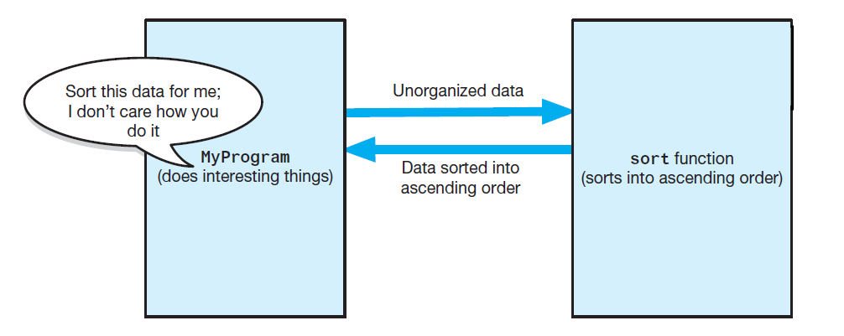
Specifications
The task sort is a module separate from the MyProgram module

Slide 8
Operation Contracts
Documents
  How method can be used
  What limitations it has
Specify
  Purpose of modules
  Data flow among modules
  Pre-, post-condition, input, output of each module

Slide 9
Unusual Conditions
Ways to address invalid conditions:
  Assume they will not happen
  Ignore such situations
  Guess at client’s intentions
  Return value that signals problem
  Throw an exception

Slide 10
Abstraction
Separate purpose of something (i.e. data, module) from its implementation
Specifications do not indicate how to implement
  Able to use without knowing implementation
Types
  Data
  Procedural
Characteristics
  Encapsulation
  Information Hiding

Slide 11
Information Hiding
Abstraction helps identify details that should be hidden from public view
  Ensured no other module can tamper with these hidden details.
Isolation of the modules cannot be total, however
  Client must know what tasks can be done, how to initiate a task

Slide 12
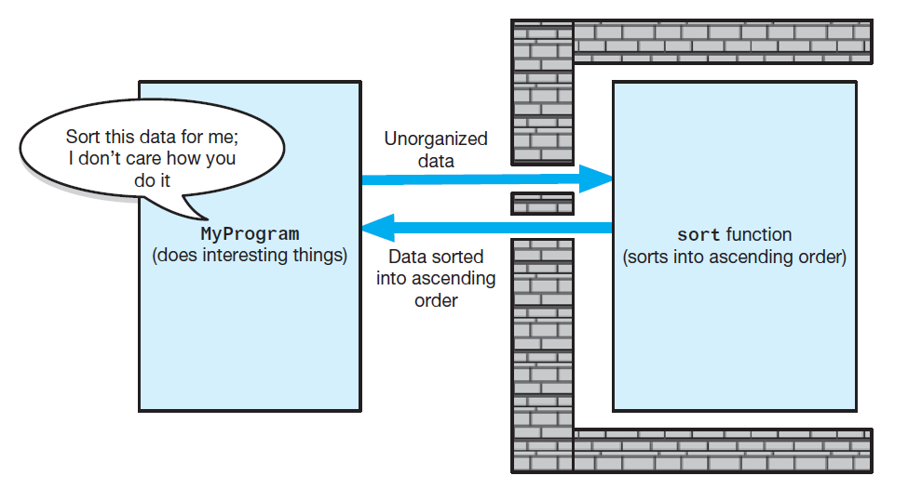
Information Hiding
Tasks communicate through a “slit in the wall”

Slide 13
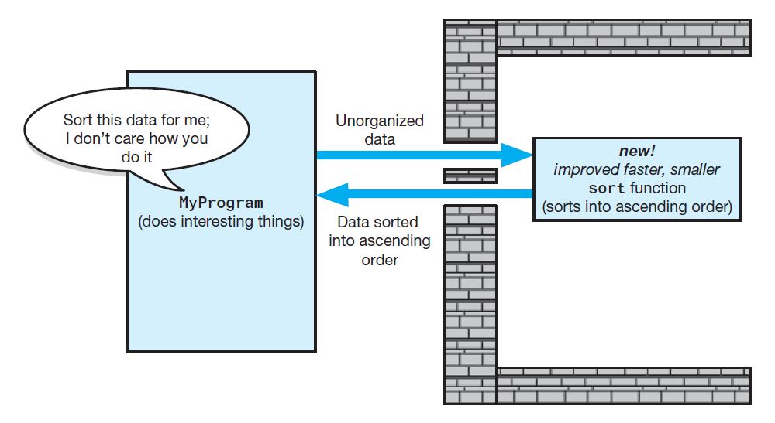
Information Hiding
A revised implementation communicates through the same slit in the wall

Slide 14
Minimal and Complete Interfaces
Interface for a class made up of publicly accessible methods and data
Complete interface for a class
  Allows programmer to accomplish any reasonable task
Minimal interface for a class
  Contains method if and only if that method is essential to class’s responsibilities

Slide 15
Abstract Data Types (ADT)
Typical operations on data
  Add data to a data collection.
  Remove data from a data collection.
  Ask questions about the data in a data collection.
An ADT : a collection of data and a set of operations on data
A data structure : an implementation of an ADT within a programming language

Slide 16
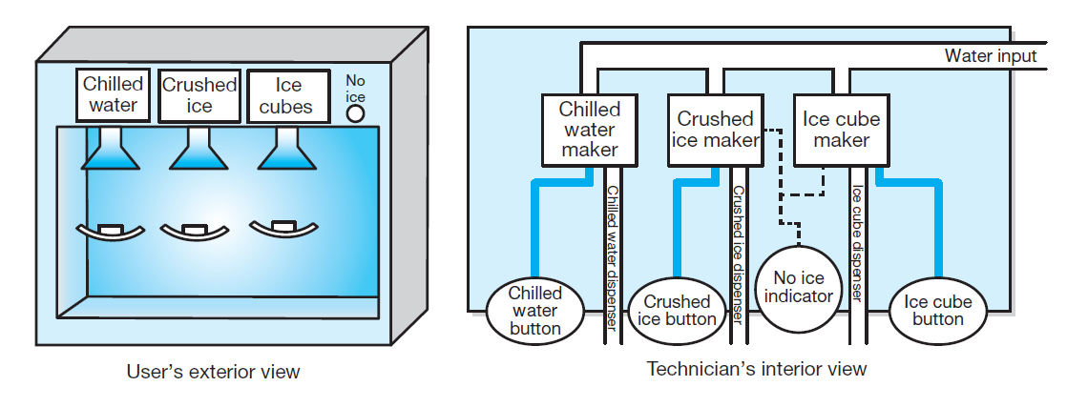
Abstract Data Types (ADT)
A dispenser of chilled water, crushed ice, and ice cubes

Slide 17
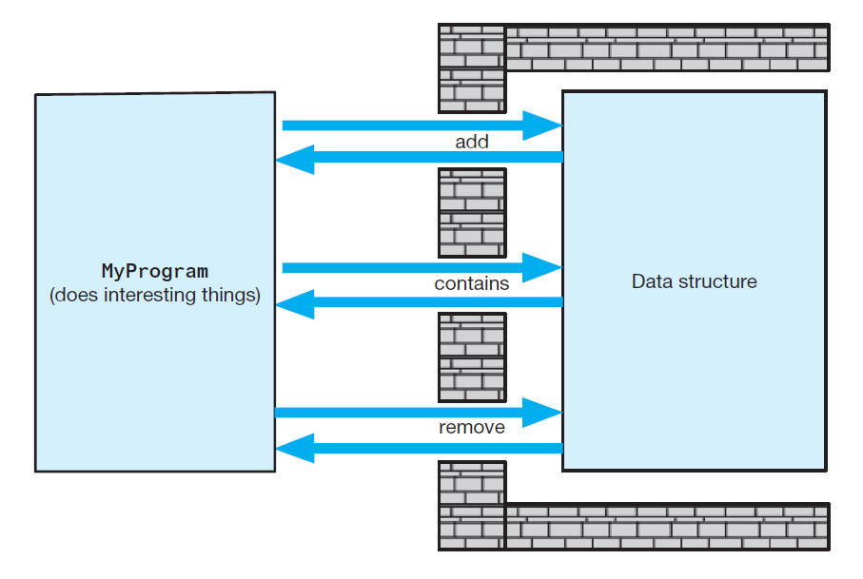
Abstract Data Types (ADT)
A wall of ADT operations isolates a data structure from the program that uses it

Slide 18
Designing an ADT
Evolves naturally during the problem-solving process
  What data does a problem require?
  What operations does a problem require?
ADTs typically have initialization and destruction operations
  Assumed but not specified at this stage

Slide 19
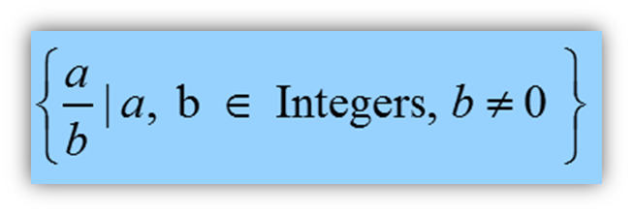
ADTs That Suggest Other ADTs
You can use an ADT to implement another ADT
  Example: Date-Time objects available in C++ for use in various contexts
  Possible to create your own fraction object to use in some other object which required fractions

Slide 20
The ADT Bag
Consider the bag to be an abstract data type.
  We are specifying an abstraction inspired by an actual physical bag
  Doesn’t do much more than contain its items
  Can have unordered and possibly duplicate objects
  We insist objects be of same or similar types
Knowing just its interface
  Can use ADT bag in a program

Slide 21
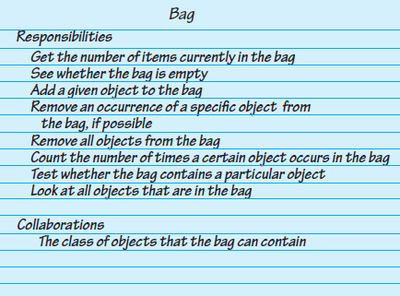
Identifying Behaviors
A CRC card for a class Bag
Notes:
Team programming uses CRC Cards: Class-Responsibility-Collaboration during brainstorming

Slide 22
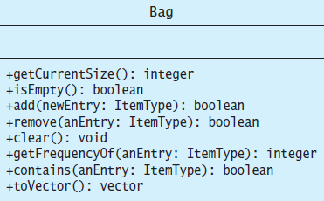
Specifying Data and Operations
UML notation for the class Bag
Notes:
stop here

Slide 23
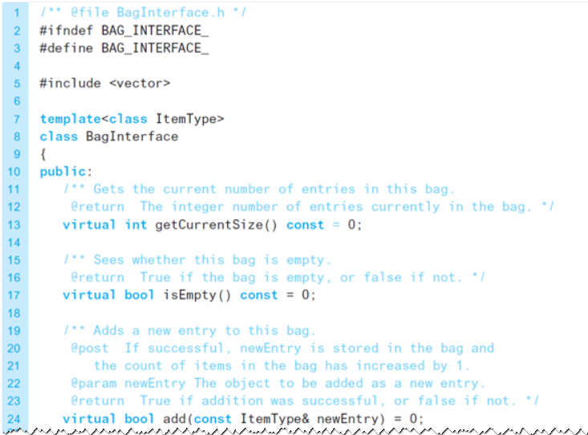
An Interface Template for the ADT
A file containing a C++ interface for bags

Slide 24
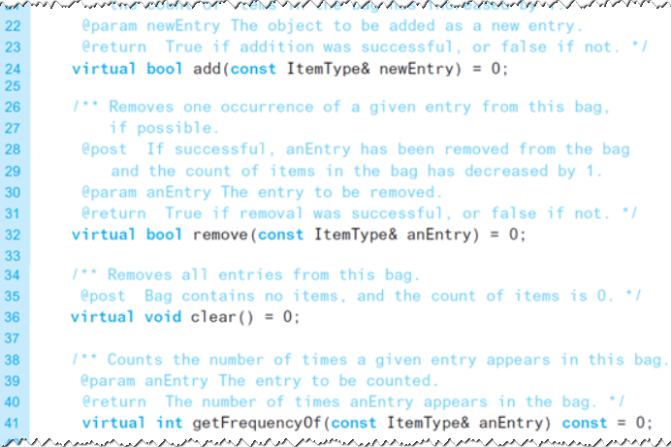
An Interface Template for the ADT
A file containing a C++ interface for bags

Slide 25
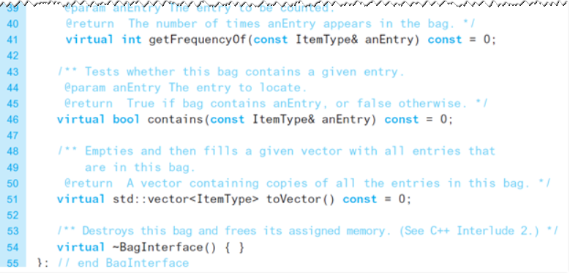
An Interface Template for the ADT
A file containing a C++ interface for bags

Slide 26
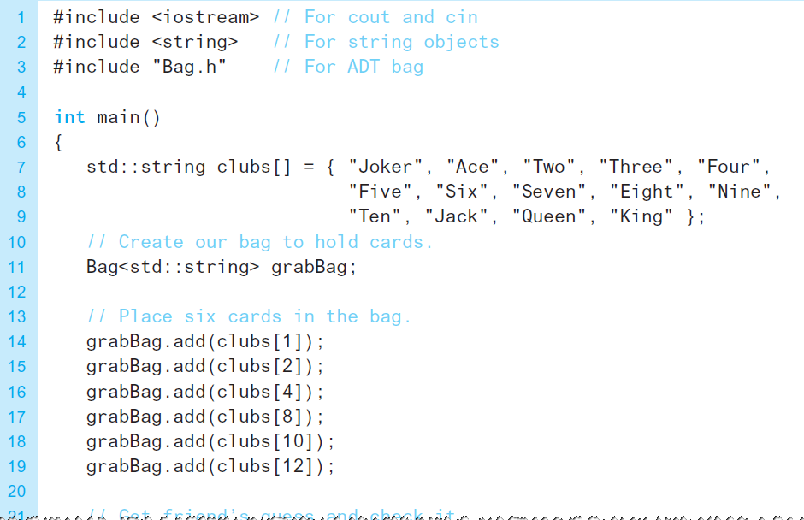
Using the ADT Bag
A program for a card guessing game

Slide 27
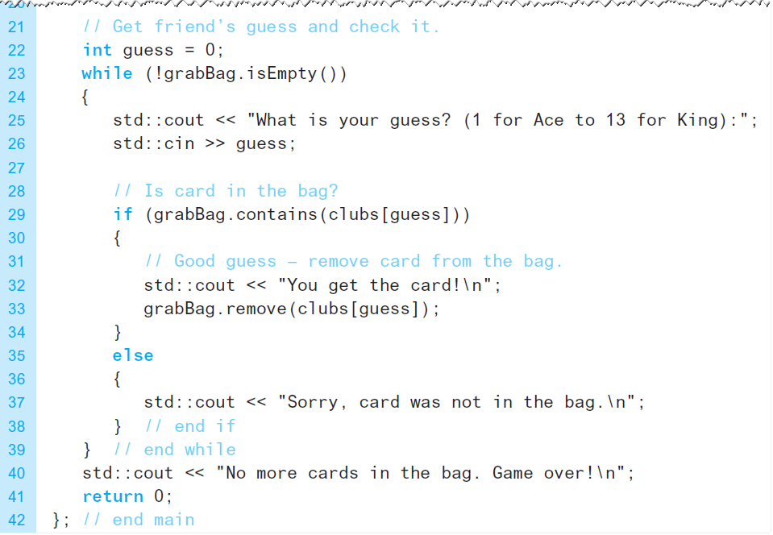
Using the ADT Bag
A program for a card guessing game

